Slide 1


Olist E-Commerce Analytics
PRESENTATION

Slide 2

TECHNICAL & ANALYTICAL FRAMEWORK
From Cleaning & Modeling to Actionable Business Insights.
Power Query
Data Modeling
DAX Measures
Cleans and transforms raw data, resolves missing values, and categorizes financial reconciliation anomalies.
Builds a Star Schema to connect Fact and Dimension tables for fast, dynamic cross-filtering
Calculates key metrics (KPIs) like Total Revenue, AOV, installment tiers, and delivery delay tracking.

Slide 3

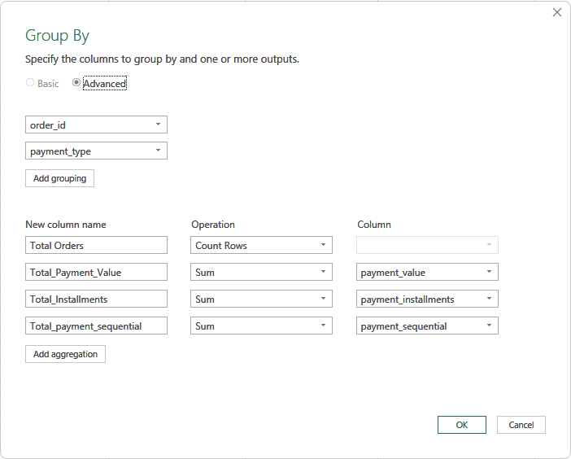
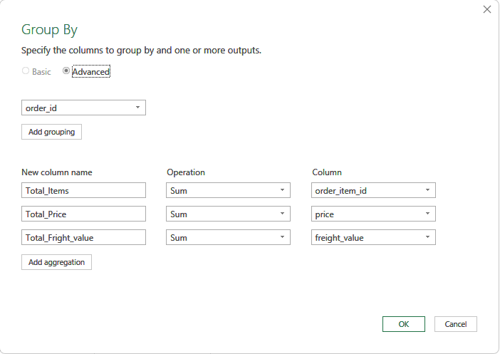
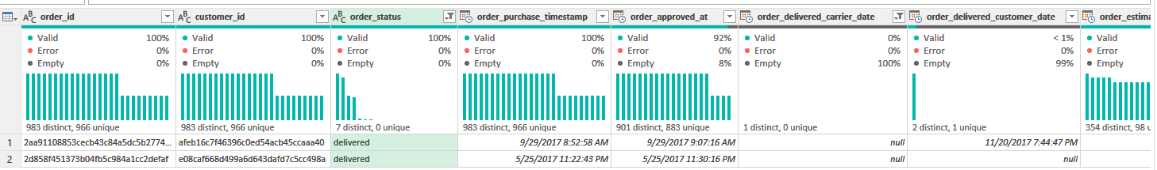
Power Query
Power Query Transformations (Summary)
Reference Queries: Created referenced queries (items_dataset & payments dataset) to preserve raw source tables.
Order-Level Aggregations (Group By):
Items: Grouped by order id to aggregate Total Items, Total Price, and Total_Freight_value.
Payments: Grouped by order_id & payment_type to calculate Total_Payment_Value, Total_Installments, and sequence metrics.
Fact Table Integration: Merged the aggregated queries into a single unified Data Base table via Merge Queries as New. After performing the Merge Queries operation to form the main Fact Table (Data Base), missing operational timestamps were detected for orders fully marked as delivered.

Slide 4
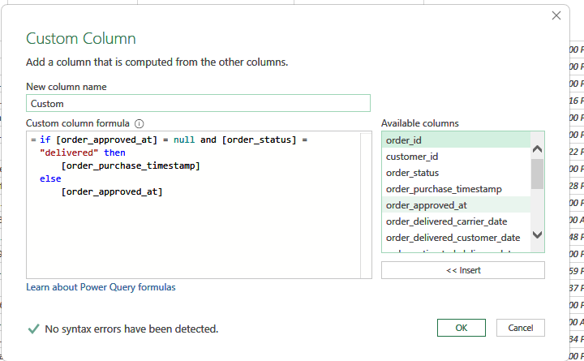
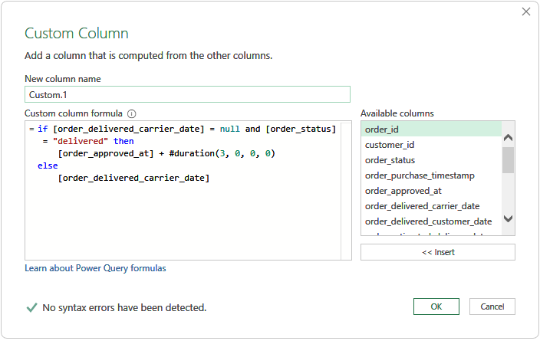
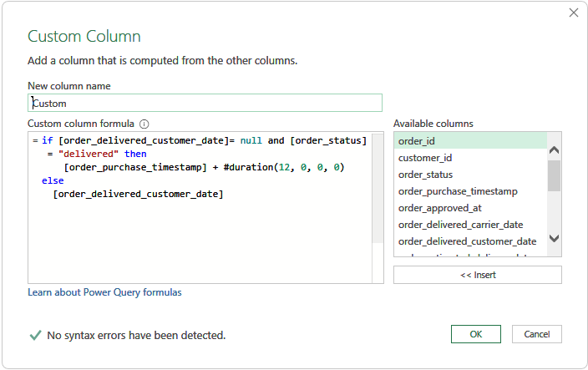
Power Query
Imputed missing order_approved_at timestamps for delivered orders using order_purchase_timestamp, as same-day order approval is standard practice. Imputed missing carrier dispatch dates (order_delivered_carrier_date) for delivered orders by adding the average dispatch lead time (3 days) to order_approved_at. Imputed missing customer delivery dates (order_delivered_customer_date) for delivered orders by adding the average order-to-delivery lead time (12 days) directly to order_purchase_timestamp.
1
2
3

Slide 5
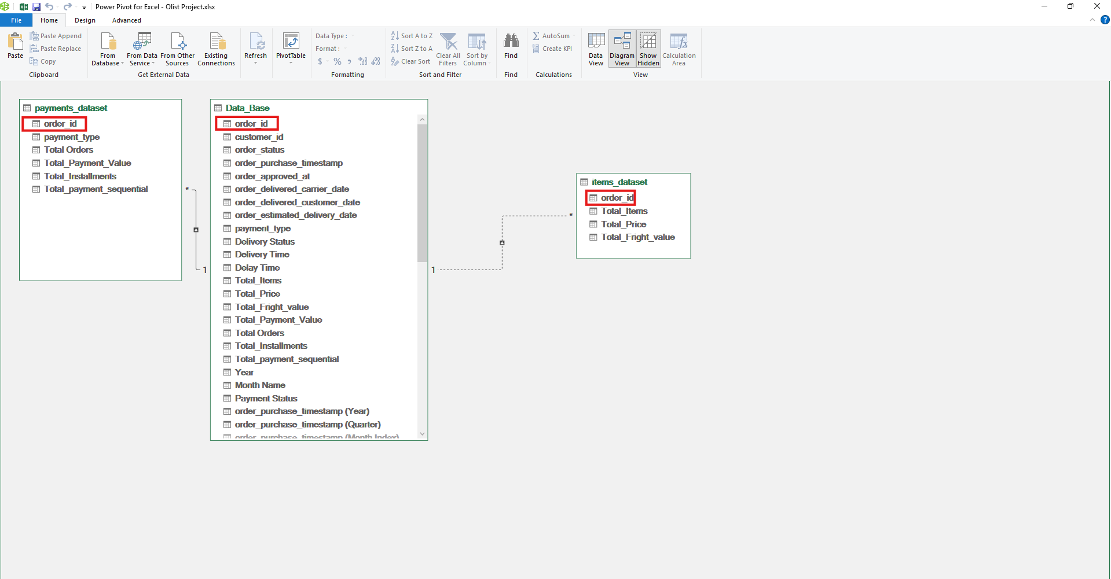
Data Modeling (Power Pivot ): Data Modeling (Power Pivot):Central Fact Table (Data_Base)Main repository for order-level timestamps, operational metrics, and delivery statuses. 1-to-Many Relationships Data_Base $\leftrightarrow$ payments_dataset: Joined on order_id to enable detailed analysis of payment types and installments .Data_Base $\leftrightarrow$ items_dataset: Joined on order_id to link product prices and freight costs. Business ImpactOptimizes memory performance and enables flexible DAX measures across multiple dimensions .
Data Modeling

Slide 6
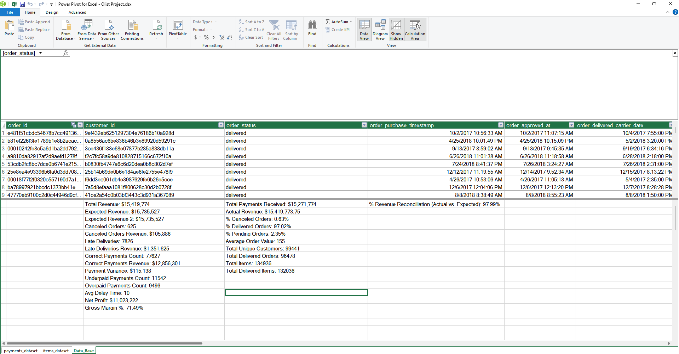
DAX Measures: Key Objective Applied DAX (Data Analysis Expressions) to dynamically calculate critical business KPIs and power analytical insights without cluttering the data model with calculated columns.
Core Analytical Domains
Financial Reconciliation Defined Total Revenue ($15.42M), Expected Revenue ($15.73M), and trackable Reconciliation % (97.99%).
Profitability & Value Modeled Net Profit ($11.02M), Gross Margin (71.49%), and Average Order Value ($155).
Fulfillment & Operations Measured Total Delivered Orders (96.48K / 97.02%), Late Deliveries (7.83K orders / 10-day avg delay), and Cancellation Loss ($105.88K).
Business Value Provides high-performance aggregation across 99.4K orders, enabling interactive filtering and accurate root-cause analysis for executive decision-making.
DAX Measures

Slide 7
Olist E-Commerce Dashboard
From Cleaning & Modeling to Actionable Business Insights.
Financial Performance
Order Breakdown
Delivery & Logistics
Tracks total revenue ($15.42M), net profit, payment methods, installment distributions, and resolves monthly financial reconciliation anomalies.
Analyzes total order volume (99.4K orders), delivery completion rates (97.02%), Average Order Value ($155.06), and customer payment behaviors.
Monitors SLA compliance, avg delay times (10 days), revenue impact of delayed shipments ($1.35M), and carrier performance timelines.

Slide 8
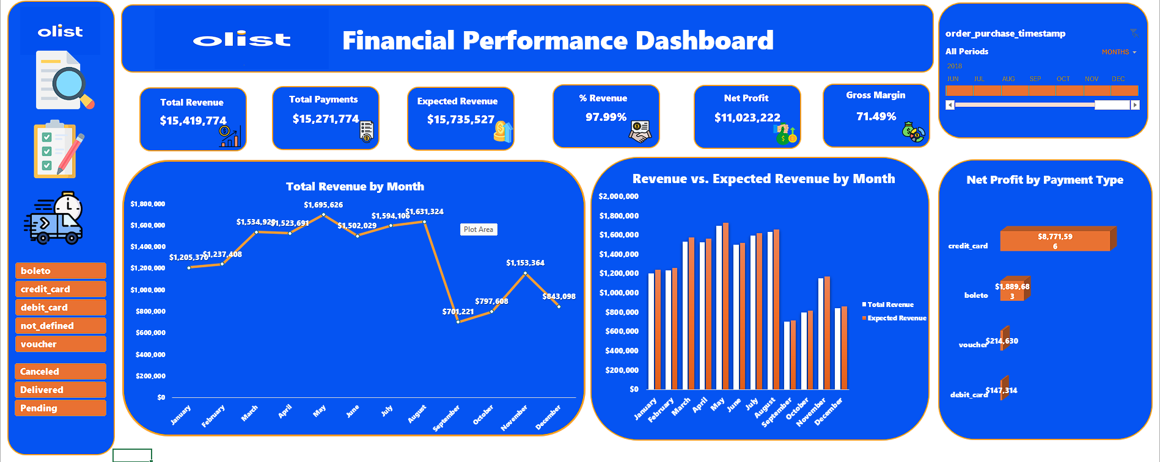
Data Scope: Comprehensive performance analysis for Olist across 3 years (2016 – 2018) to evaluate sales growth, net profitability, and operational efficiency.
Financial Highlights: Generated $15.42M in Total Revenue with $11.02M in Net Profit, achieving a strong 71.49% Gross Margin.
Operational Scale: Delivered orders scaled dramatically from 267 orders in 2016 to over 52,000 orders in 2018, improving fulfillment success to 97.73%.
Data Context: The late-2018 volume drop is identified as a Data Truncation Effect (cutoff date in September 2018) rather than an operational decline.
Financial Performance Dashboard
Recommendations:
Fix Data & Reconciliation Gaps: Resolve Data Logging bugs to Bridge the Revenue Gap: Expedite Pending order processing and address cancellations to minimize the $315K Revenue Gap.
Capitalize on Gross Margin: Reinvest a portion of the 71.49% Gross Margin into targeted marketing campaigns and promotional offers to drive further acquisition.
Optimize Payment Mix: Incentive customers toward Debit Cards to diversify payment methods and lower high Credit Card transaction processing fees.

Slide 9
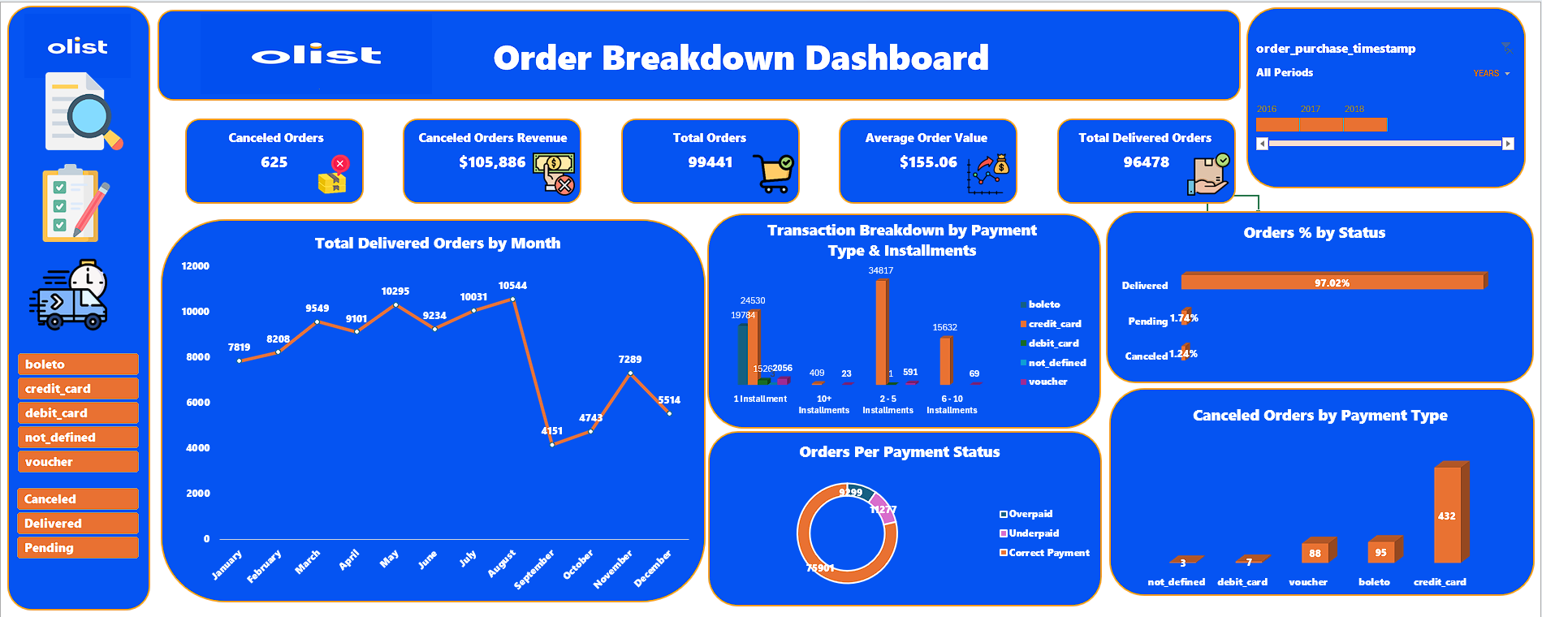
Data Scope:
Multi-Year Analysis (2016–2018): Evaluated 99,441 total orders to analyze consumer purchasing behavior and order fulfillment stability. Payment Method Breakdown: Credit Card: 75,388 orders (75.8%) — Dominates platform transactions, with 2–5 installments being the primary preference (34,817 orders). Boleto : 19,784 orders (19.9%) — Second most used method, strictly 1-installment cash transactions. Voucher & Debit Card: Represent 2,739 and 1,527 orders respectively. Cancellation Focus: Addressed 625 total cancellations ($105.8K lost revenue), led by Credit Card (432 orders) and Boleto (95 orders). Strategic Objective: Balance payment gateway usage by promoting low-cancellation channels (Debit Cards) and mitigating high-cancellation methods (Credit Cards & Boleto ) via targeted offers.
Order Breakdown Dashboard
Recommendations:
Mitigate Credit Card Cancellations: Target the most used and canceled method (432 cancellations) with Instant Checkout Discounts (2%–3%) and seamless 0% interest installment plans (2–5 months) to curb impulse drop-offs.Shift Volume to Debit Cards (Payment Balance): Create Cashback campaigns for Debit Cards to balance gateway reliance and drive customers toward low-cancellation channels (only 7 cancellations).Convert Boleto to Instant Payments: Offer immediate incentives (e.g., 5% off) for switching from Boleto (95 cancellations) to direct instant pay, eliminating the 1–3 day delay window where orders drop.Optimize Voucher Workflows: Streamline voucher validation during checkout to resolve technical barriers causing high cancellation rates relative to usage (88 cancellations).

Slide 10
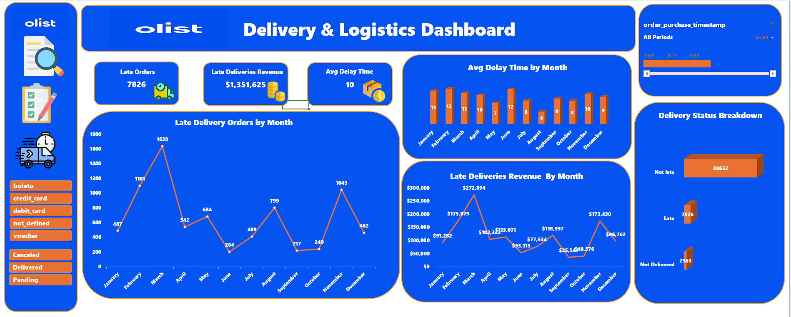
Delivery & Logistics Dashboard
Data Scope :
Operational Timeline (2016–2018): Analyzed multi-year logistics performance to track delivery reliability and fulfillment timelines.
Volume Breakdown:
Not Late: 88,652 orders delivered on or before the estimated target.
Late Deliveries: 7,826 orders experienced fulfillment delays.
Not Delivered: 2,963 orders failed or remained unfulfilled.
Logistics Bottlenecks & Revenue Loss: Late orders impacted $1.35M in revenue, with an average delay of 10 days.
Seasonal Peak Disruptions: Delays spiked severely in March (1,638 late orders / $272.8K revenue affected) and November (1,043 late orders / $173.4K revenue affected).
Recommendations: Mitigate Peak-Season Delays (Q1 & Q4 Bottlenecks): Partner with regional 3PL logistics carriers to expand capacity during Q1 (March spike) and Q4 (November/Black Friday spike) to reduce the 10-day delay window. Recover Revenue at Risk ($1.35M): Implement proactive SMS/Email delivery tracking and automated compensation credits (e.g., $5 shipping voucher) for delayed shipments to protect customer retention. Address Non-Delivered Orders (2.9K Orders): Audit carrier performance to identify route-specific failure causes and set dynamic shipping promise dates (SLA adjustments) for high-risk zones. SLA Threshold Monitoring: Establish automated backend alerts for shipments exceeding 4 days of transit delay (well below the current 10-day average) to allow manual escalation before orders drop.

Slide 11

THANK YOU

